Slide 1


PROJ NAME
VALUE PROP
ELSIE
ALIX
CONSTANCE
JIALIN
Sprout
Collaborators for an instant,
Connections for a lifetime.

Slide 2



Growth in the music industry revolves around networking.
But networking for small creators is either awkward or sparse.
How can we make networking feel organic and genuine for music lovers?
Notes:
We have identified that the growth in the music industry revolves around networking. But networking can be awkward and stressful at times. SO how can we make it feel more organic and genuine for all music lovers. Let’s find out together

Slide 3
Roadmap
Mission Statement
Low-Fi Prototype
UI Changes
1
3
5
2
4
6
Selected Interface
Experiment
Summary
‹#›

Slide 4
Roadmap
Mission Statement
Low-Fi Prototype
UI Changes
1
3
5
2
4
6
Selected Interface
Experiment
Summary
‹#›

Slide 5

Mission Statement
Our goal is to empower music creators to network comfortably by fostering quick, creative collaborations.
Notes:
Just like our value proposition we want to be users of sprout to collaborate for an instant, but form connections for a lifetime. Our goal is to empower music creators to network comfortably by fostering quick, creative collaborations.

Slide 6
Roadmap
Mission Statement
Low-Fi Prototype
UI Changes
1
3
5
2
4
6
Selected Interface
Experiment
Summary
‹#›

Slide 7
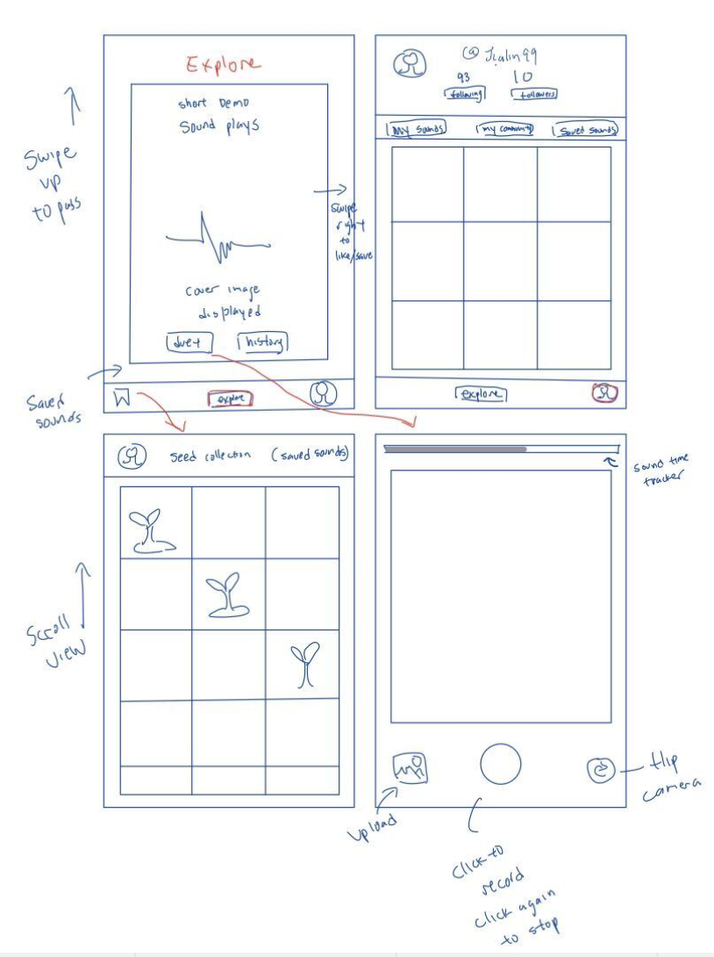
Swipe Interface
View one soundbite at a time, swipe to view the next one
Notes:
One of the top 2 interfaces we selected was the swipe interface where users gets to view one sound bite at a time and swipe up to go to the next soundbite (tiktok). Then the users can save sounds to a collection that can be visited at any time.

Slide 8
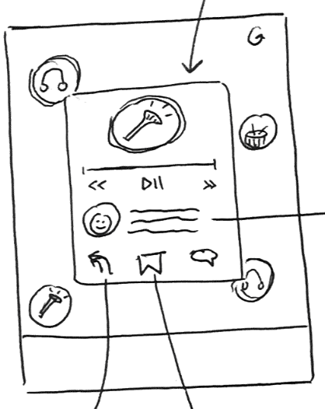
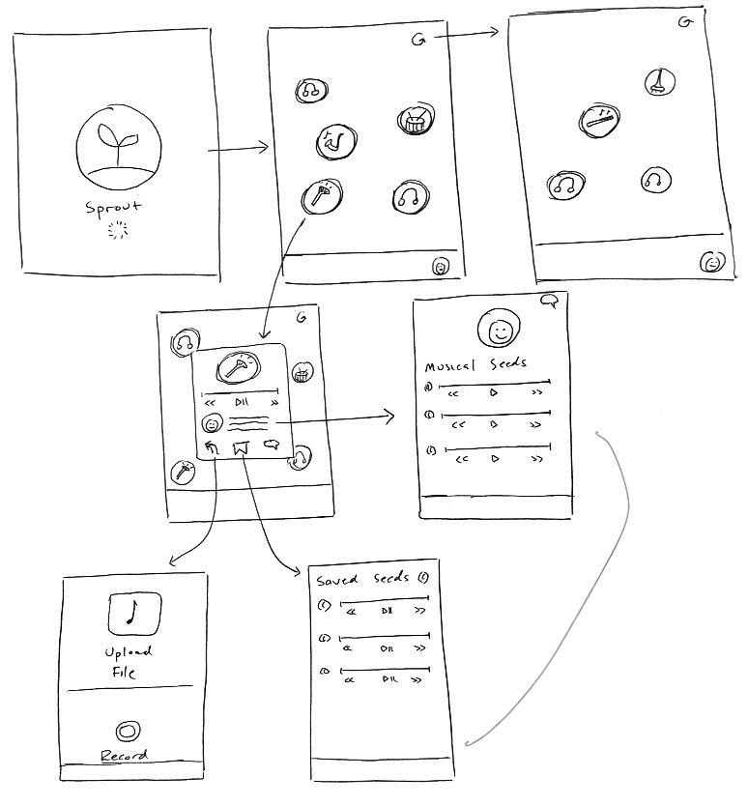
2. Bulk Interface
The bulk view presents multiple soundbites on screen at once, allowing for genre filtering and easy comparisons between soundbites.
Notes:
The other interface we selected was the bulk view. Unlike the swipe interface, multiple soundbites are displayed on the screen at once in circular forms like bubbles.
When a bubble is clicked on a pop-up page will show up. When the user wants to see a new set of sounds they can simply click on the refresh button on the top

Slide 9
Diving deeper
Novel and unique design, visually engaging
Notes:
Decided on the Bulk Interface
The swiping interface is very common in other applications so this bulk interface less repetitive, boring, and mechanical. Plus it is more visually engaging as the colors wrapping the soundbites attract more attention

Slide 10
Diving deeper
Novel and unique design, visually engaging
Easier to revisit a previously listened to soundbite
Notes:
In addition, it is easier to revisit a previously listened to soundbite. Swiping interface requires multiple gestures and makes it easy to lose specific soundbites

Slide 11
Diving deeper
Novel and unique design, visually engaging
Easier to revisit a previously listened to soundbite
Gives more exposure to smaller artists
Notes:
Bulk interface encourages comparison based selection instead of instant selection which is used in the swiping interface. Because users get to see multiple sounds at a time, they are more likely to select a lesser known artist beca’use their decision is also influenced by other soundbites in the bulk view. The swiping interface forces the user to make a decision right then and there which puts in added stress for the user which may compromise their choice to mix a soundbite. Also, user has the control for the level of customization of the bubbles through the filtering function

Slide 12
Roadmap
Mission Statement
Low-Fi Prototype
UI Changes
1
3
5
2
4
6
Selected Interface
Experiment
Summary
‹#›

Slide 13
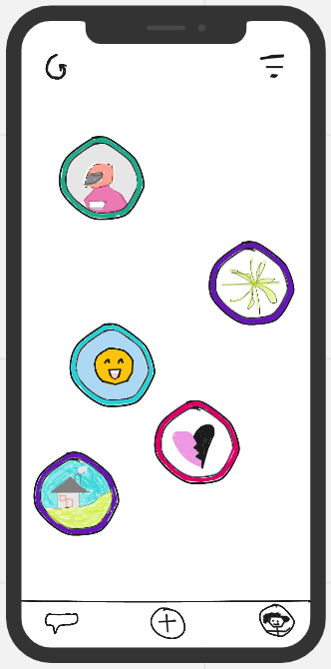
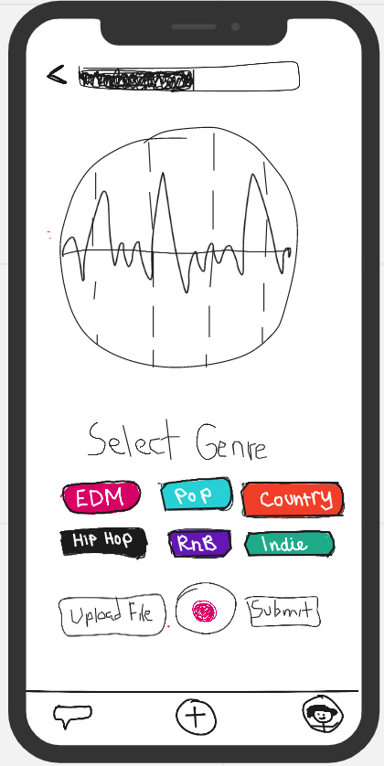
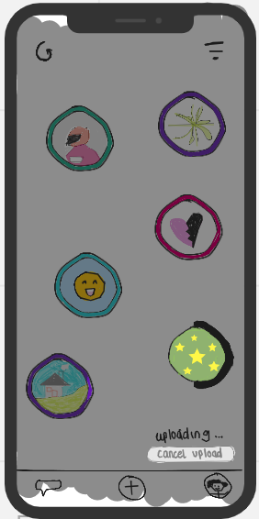
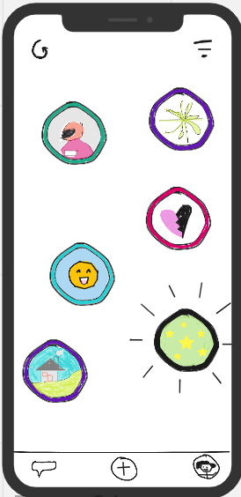
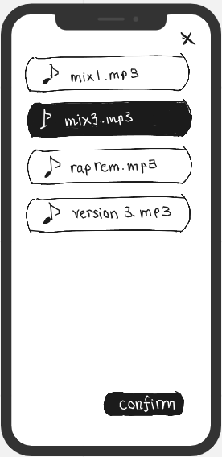
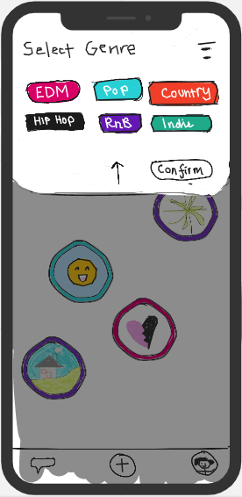
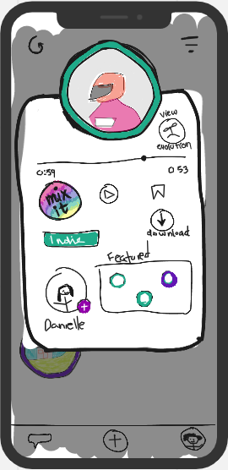
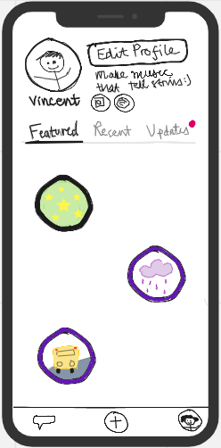
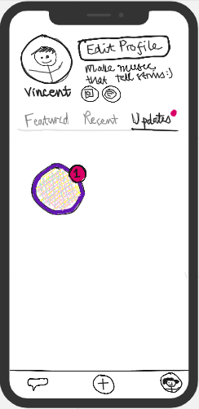
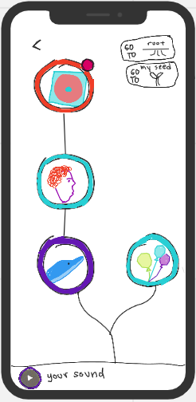
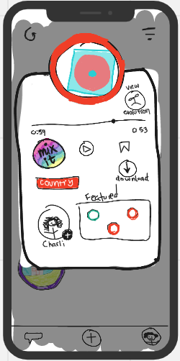
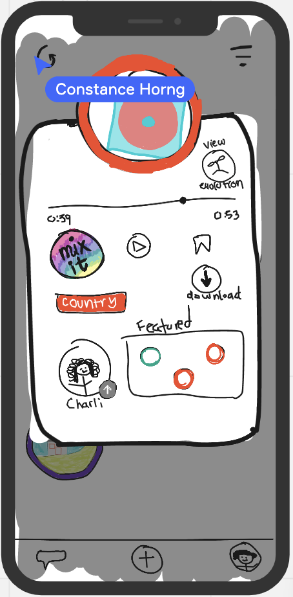
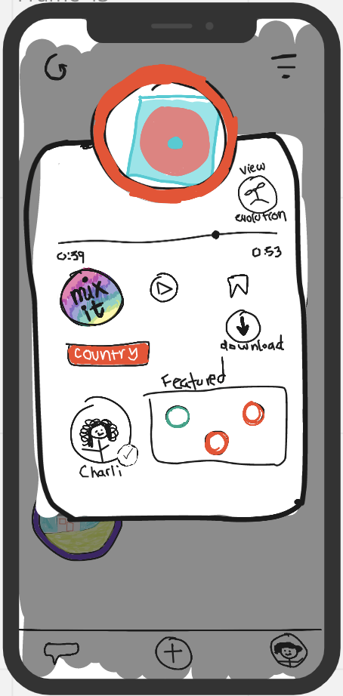
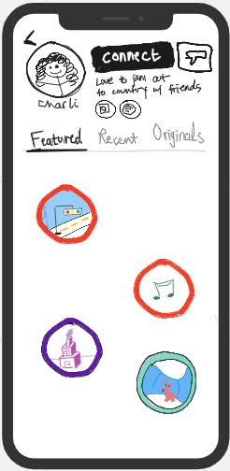
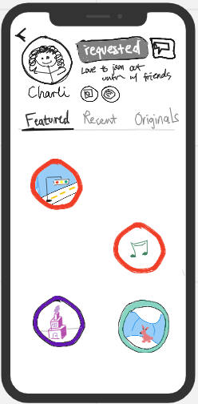
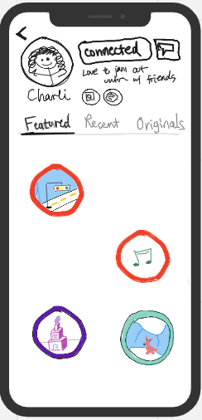
Low-Fi Prototype Structure
Notes:
Our prototypes are all hand drawn and mimic the phone interface

Slide 14


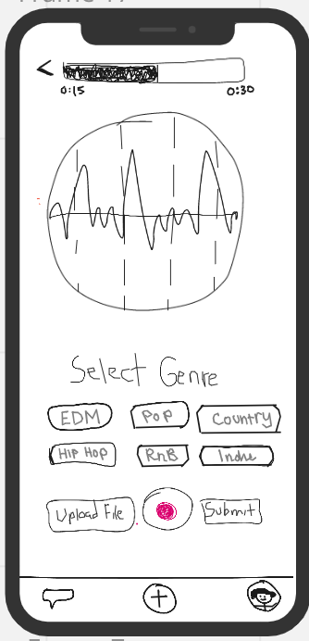
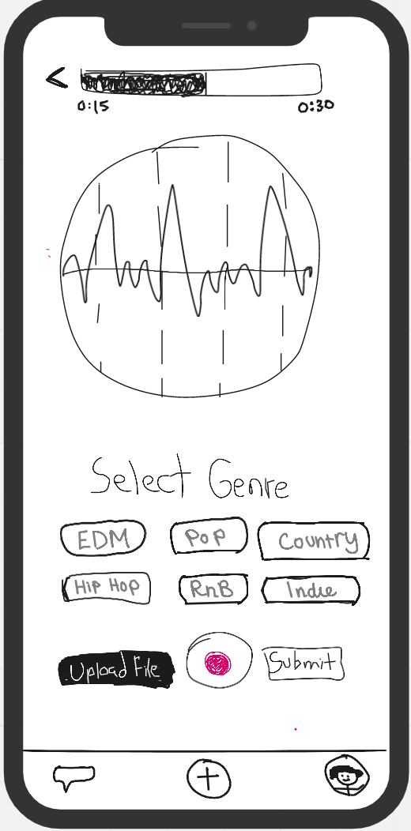
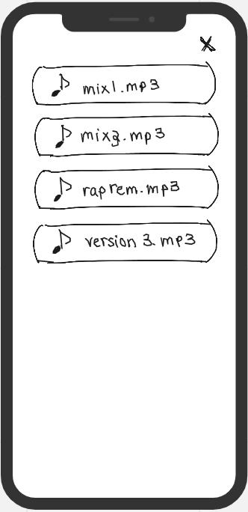
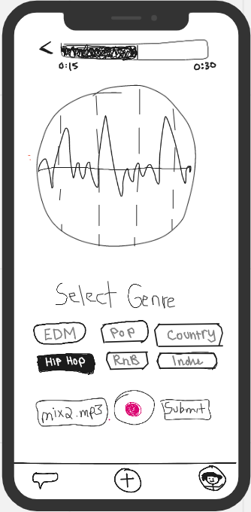

Post a soundbite
[SIMPLE]
Notes:
we instructed the participants to upload an original soundbite called mix3.mp3 and label it as a Hip Hop beat.

Slide 15


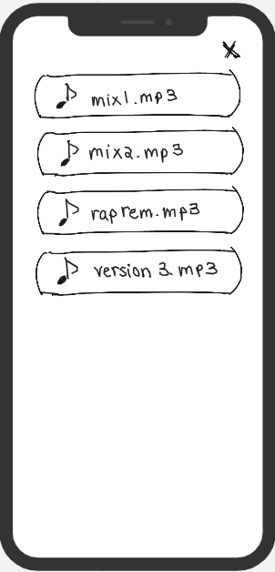
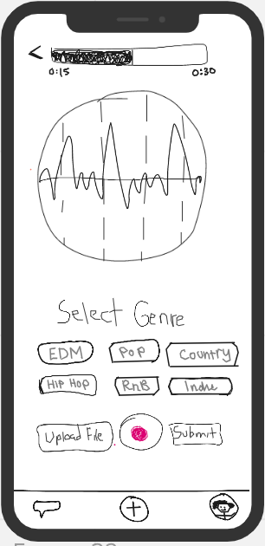
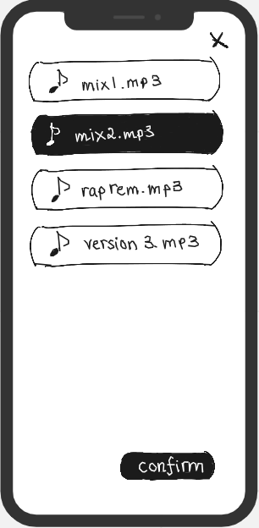
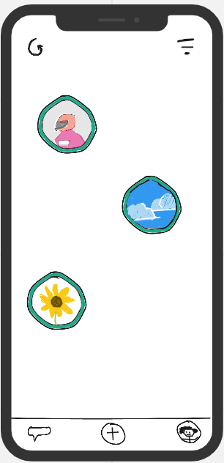
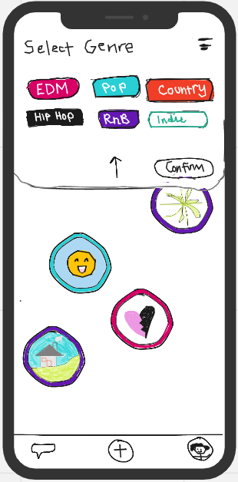
Reply to a soundbite
[MODERATE]
Notes:
In task 2, the user needs to find a indie sound to play with then upload the sound after they added their own span

Slide 16


Track your soundbite’s evolution & connect with a remixer
[COMPLEX]
Alternate way of connecting -->
Notes:
We told to participants to to assume they been a user for a while, and have posted some soundbyte mixes. They need to try checking whether there have been any updates to someone mixing one of their soundbytes. If there have been, go ahead and send a connection request.

Slide 17
Roadmap
Mission Statement
Low-Fi Prototype
UI Changes
1
3
5
2
4
6
Selected Interface
Experiment
Summary
‹#›

Slide 18



Methodology (participants)
College Student + DJ/producer
Los Angeles, CA
Professional guitarist in band
Portland, OR
Freelance singer
New York City, NY
Notes:
We realize that our app is mostly targeted towards younger music creators, so all of our participants were under 50 years old.
To diversify our participants, we sourced from platforms such as Twitch, TikTok, Instagram, and Reddit
All the participants have different backgrounds with music, ranging from college student, professional musicians and a freelance singer.
No compensation were given

Slide 19
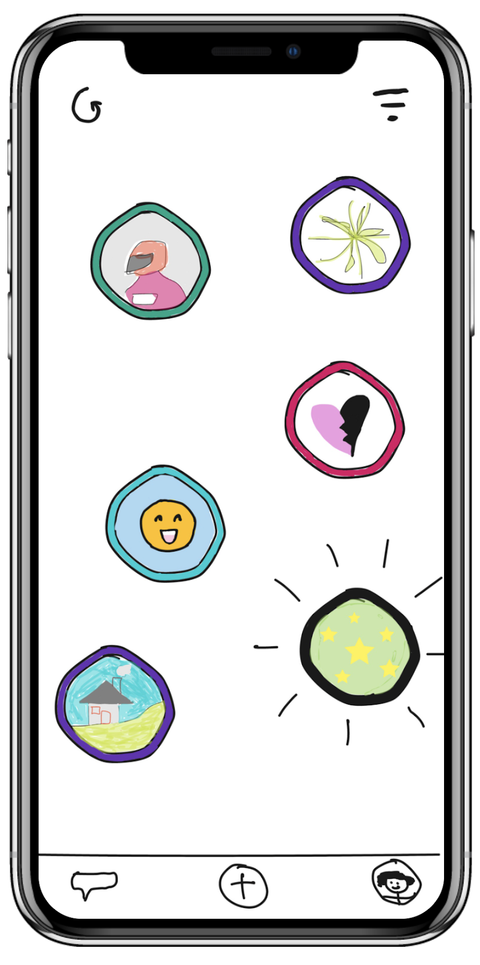
Methodology (environment)
Utilized Marvel to simulate an interactive prototype
Users were tested using a mobile interface with clickable icons and various animations
Encouraged thinking out loud and emotions during interview
Made note of what users said and how they acted e.g. facial expressions, nonverbal language, fluidity of moving through the tasks
Debrief session after every task
Ability to gain information based off of fresh thoughts and experiences from the participant
Notes:
We created hotspots to make the intended connections between different pages, simulating a mobile experience
We gave a quick demo of how to use marvel and interact with the interface
We encouraged them to think out loud while completing the task.
To make sure the experience is still fresh in their minds we asked them to debrief on how they felt during the process after each task
At the end of all tasks we asked them to debrief again
during the whole interview we took notes on positive and negative reactions/feelings, any difficulties the participant encountered during completion of task

Slide 20
Results

Slide 21
Successes
Participants were extremely excited by the novel idea, and all agreed they would use the app
“This is cool and very cute”
“It was pretty intuitive like Instagram and other social media sharing platforms”
All thoroughly enjoyed the design and the unique approach to networking
Notes:
Everyone mentioned that they loved the concept/idea and expressed that it is definitely an app they would use.
Simple task was very straightforward, all participants completed quickly
Profile button in the bottom corner was super intuitive (knew they would need to click that to see their own page)
Red dot to signify update draws user’s attention/obvious to click

Slide 22
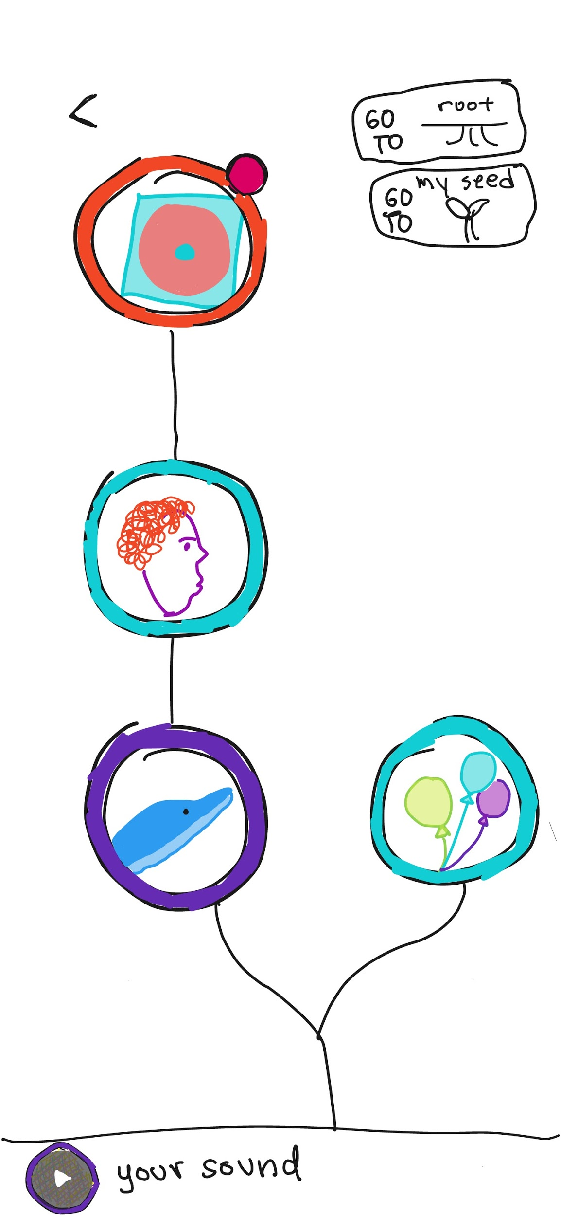
Improvement
Soundbite evolution screen caused lots of confusion
Issues with understanding the tree concept
Users spent an average of 32.3 seconds on this page before being able to navigate to the next part of the task
Soundbite Evolution
Notes:
One of the biggest confusions were from the evolution pahe. Participants were confused by the bottom up view because their eyes are drawn to the top node with a red notification

Slide 23
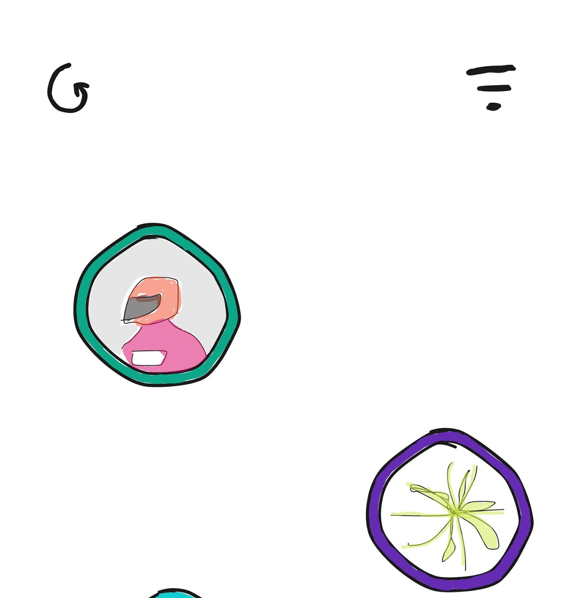
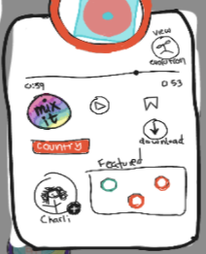
Improvement
Filter icon
Trouble finding certain buttons
⅔ users struggled or did not complete our subtask of filtering the soundbites by genre: they attributed this to unfamiliarity with the filter icon
Sound pop-up Page
Lack of white space
⅔ users felt the sound pop-up page was too crowded
Notes:
They also had trouble finding/using certain buttons
Filter option not obvious
Filter icon not indicative of its function
Too many buttons on the pop-up connect page so it is overwhelming to find the desire button

Slide 24



Post a soundbite
[SIMPLE]
Reply to a soundbite
[MODERATE]
Overall Results
Connect with a remixer
[COMPLEX]
Track your soundbite’s evolution
[COMPLEX]
Notes:
Simple task was straightforward for all participants
⅔ participants did not use the intended button to complete the task
All participants were confused by the evolution of the sound
Task 1: 10-20s
Task 2: 30-45s
Task 3: 60-90s
But user gained familiar very quickly

Slide 25
Roadmap
Mission Statement
Low-Fi Prototype
UI Changes
1
3
5
2
4
6
Selected Interface
Experiment
Summary
‹#›

Slide 26

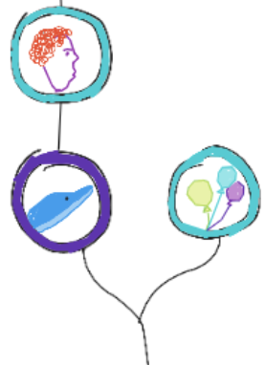

Suggested Changes
Redesign the soundbite evolution screen
Problem: the structure is not indicative of its function; users read from top to bottom instead
Solution: add a root node at the bottom to indicate the bottom up user flow

Slide 27
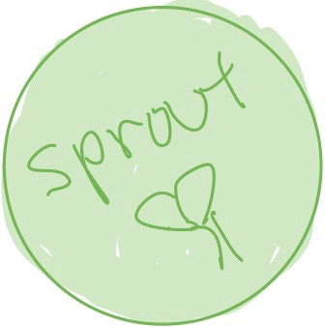
Suggested Changes
Rename the “mix it” button
Problem: “Mix-it” is a technical term for producers so it is misleading
Solution: “SPROUT!” emphasizes the evolution aspect of the soundbite collaboration feature

Slide 28

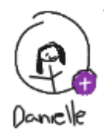

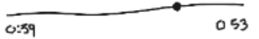


Suggested Changes
Soundbite popup unclutter
Problem: a lot of buttons and features which can be overwhelming
Solution: reorganizing the layout and remove unnecessary components

Slide 29




Discussion/Next Steps
Train vs Duet format
Less vs More genres
Modern vs Detailed theme
Notes:
These discussions extended from contradicting points/feedback we got from our participants.

Slide 30
Roadmap
Mission Statement
Low-Fi Prototype
UI Changes
1
3
5
2
4
6
Selected Interface
Experiment
Summary
‹#›

Slide 31
Summary
“It’s amazing how this is different from other social media platforms”
“This is so interesting! ”
“Oh yeah, that makes sense now”
“From these small sounds I get learn about other creator’s style and can find good long term partners”
“I would definitely use this app.”
Notes:
Users loved the concept and mission behind the app
Differentiates from other social media platforms
Geared towards music creators specifically
After explaining the functionality of missed icons, participants found them intuitive
Tutorial at the beginning to enable familiarity

Slide 32
Appendix

Slide 33
Appendix Info
Consent Forms
Additional needfinding & experience prototype guides + artifacts in folder.
Interview Notes
Dustin
Jason
Preston
Miro Workspace with ALL ANALYSIS
Sketches + Storyboards
Interview Debrief

Slide 34
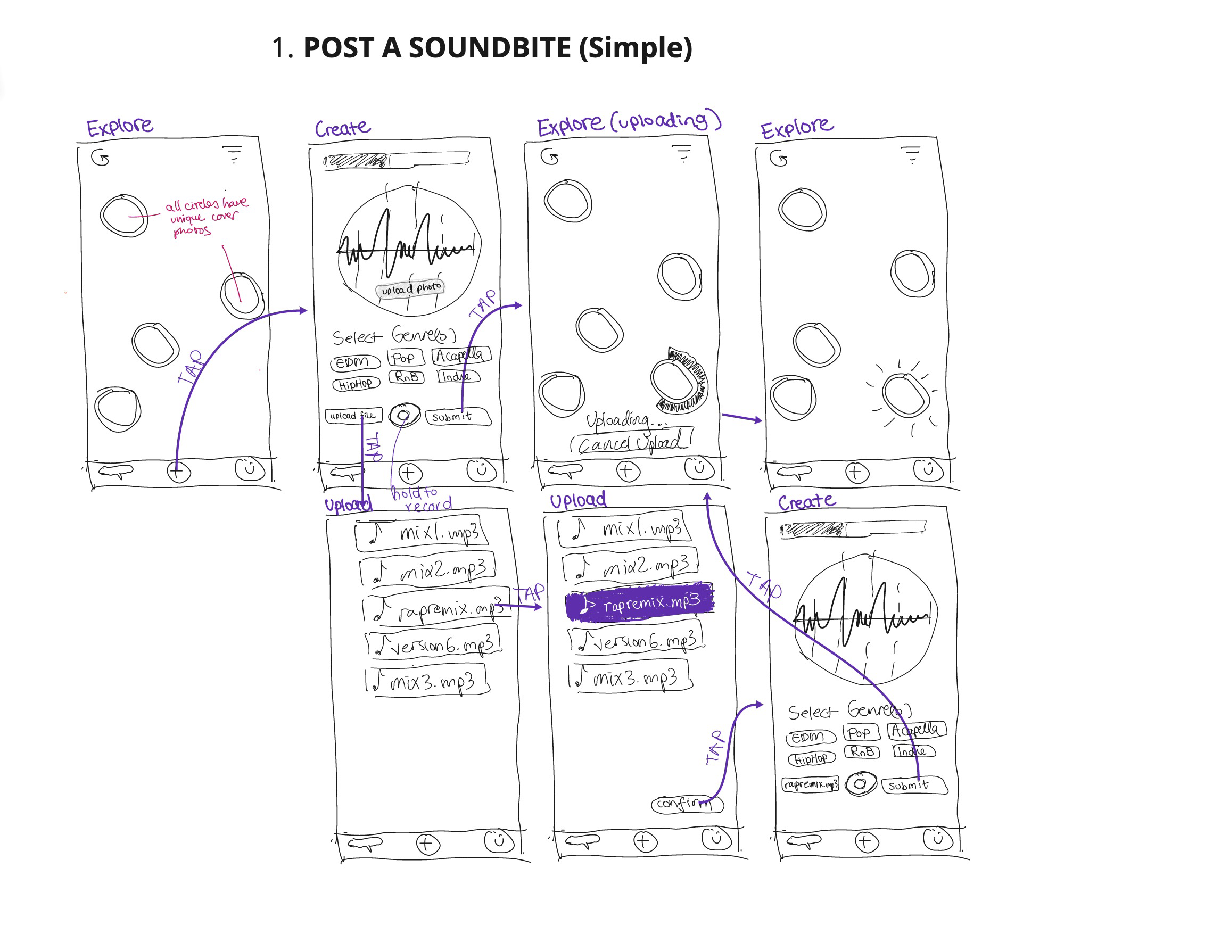
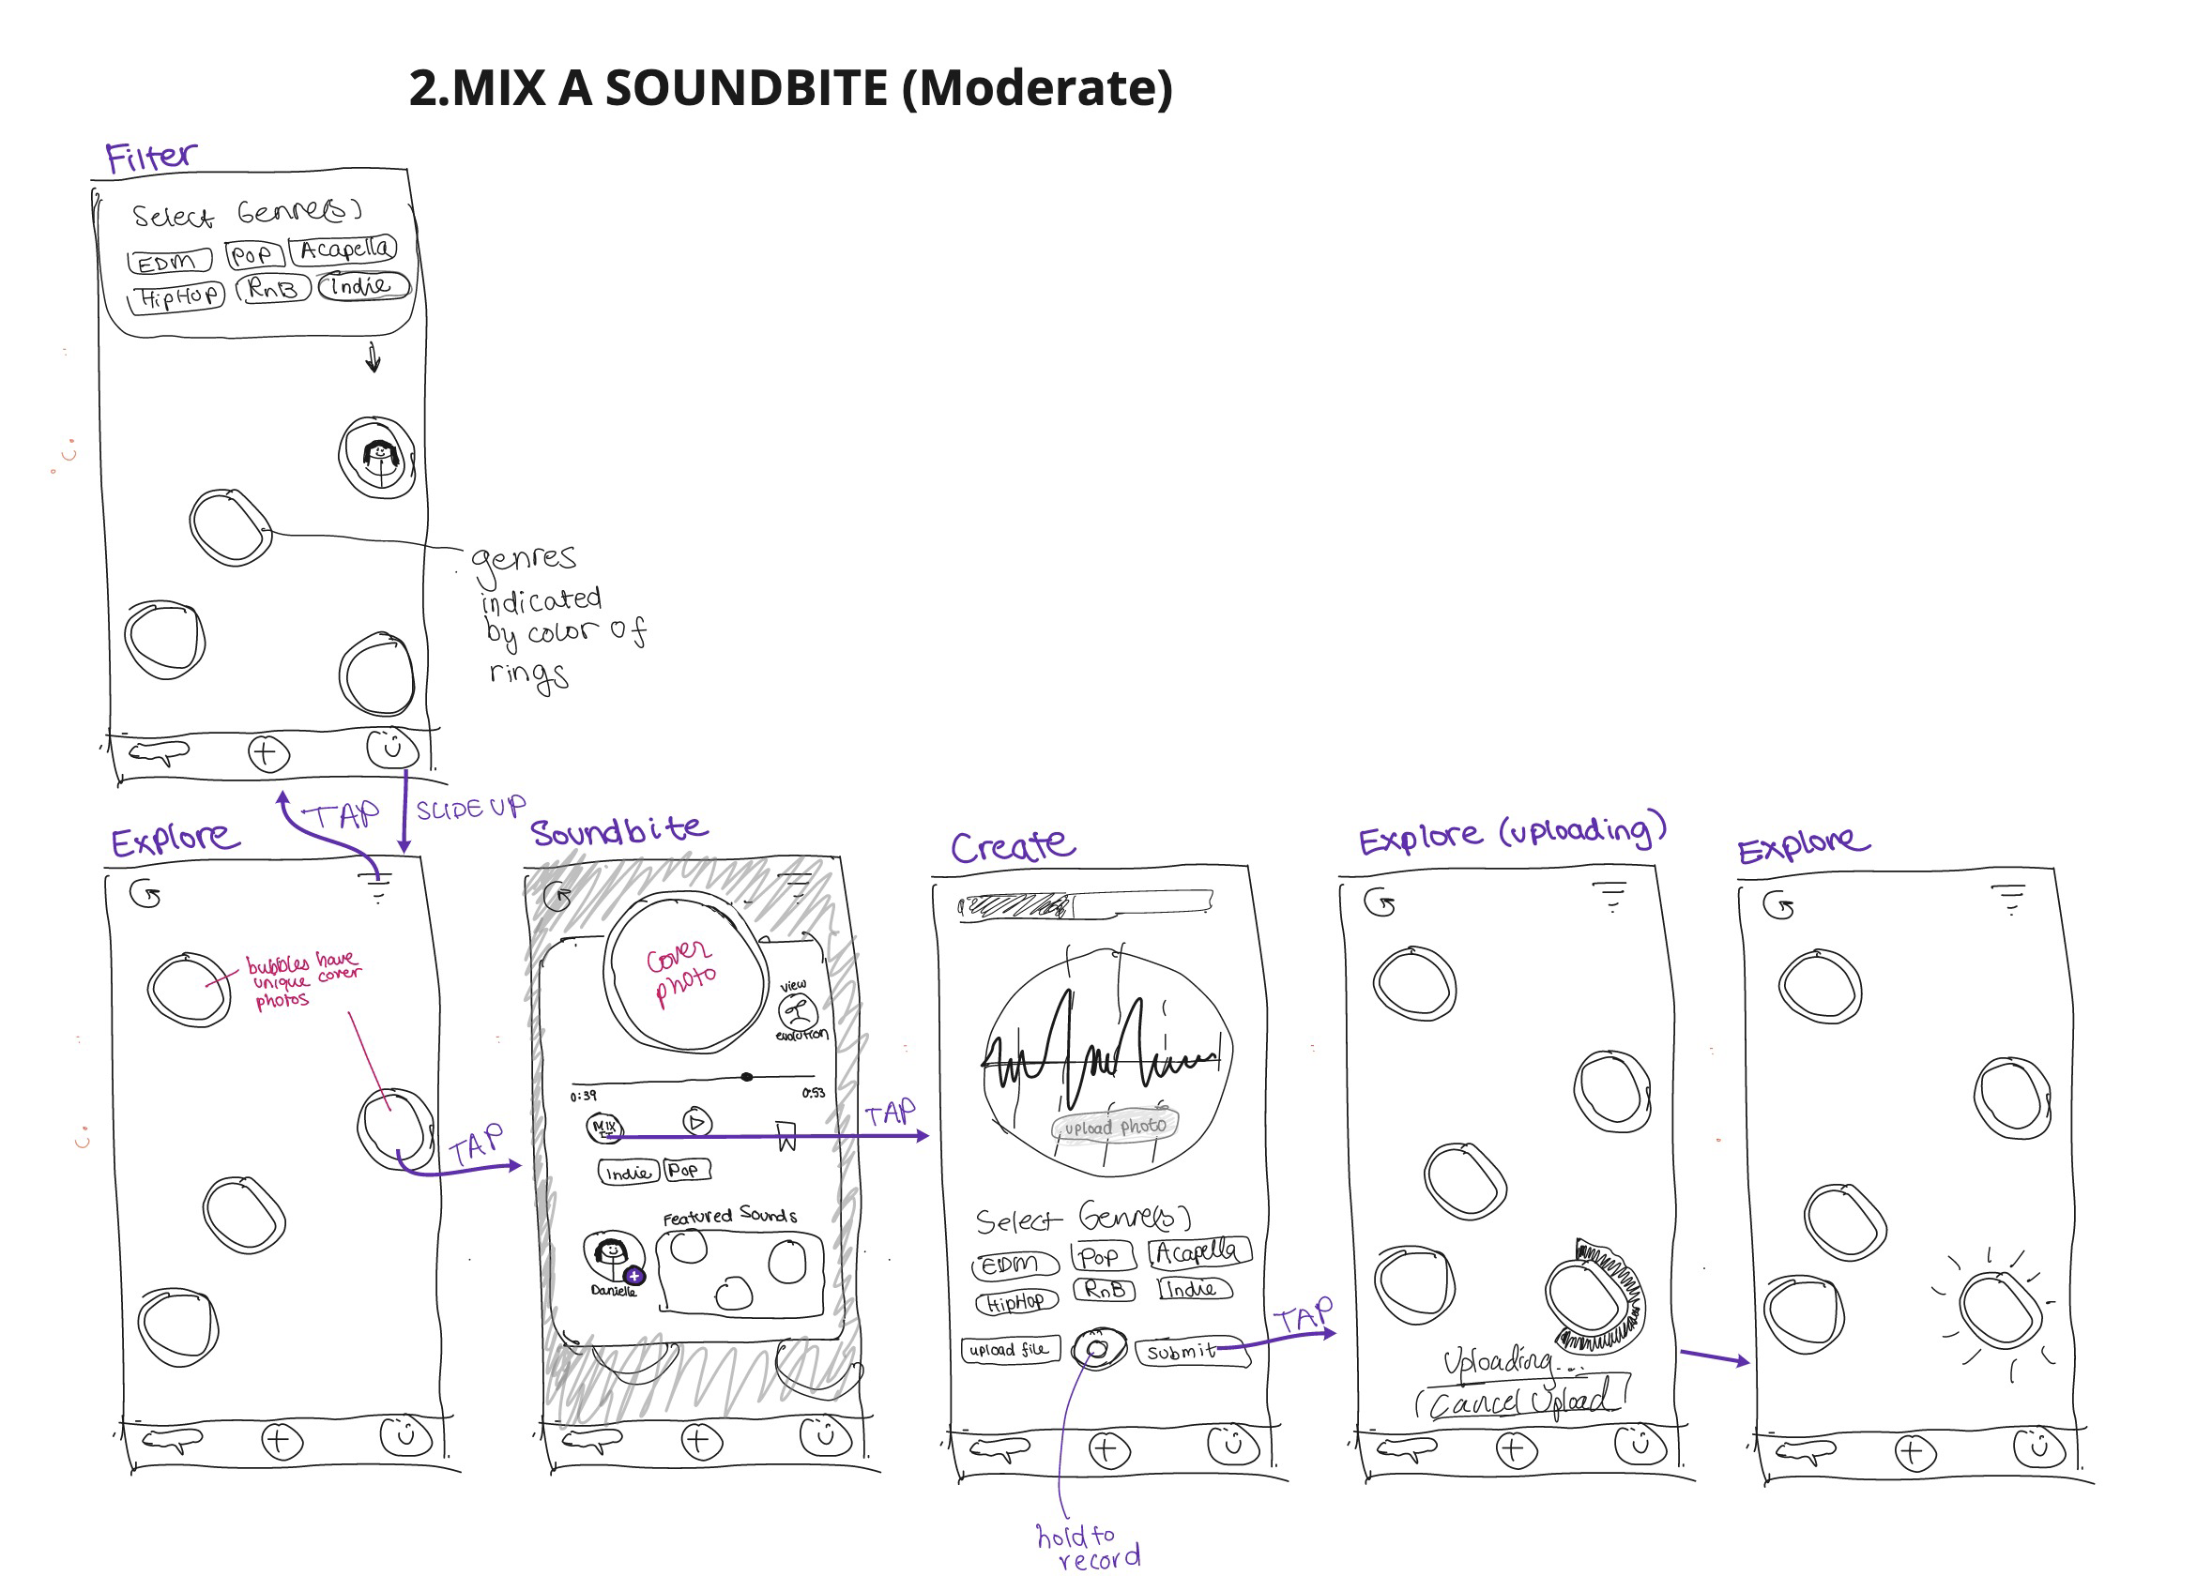
Selected Interface Task Storyboards

Slide 35
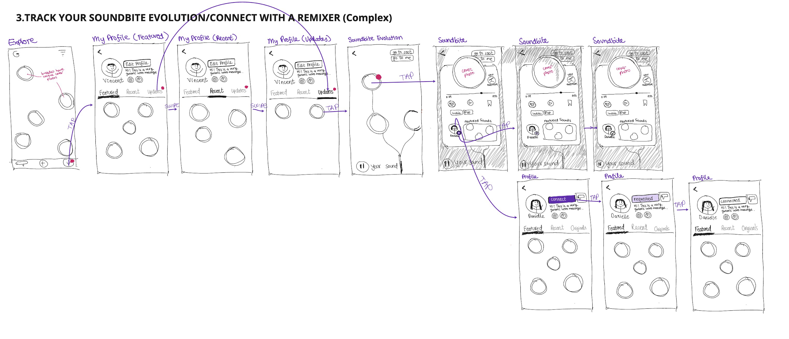
Selected Interface Task Storyboards

